Slide 1
SECTION 337 Friend or Foe?
MarkPatent.Org
10th Annual International Seminar on Intellectual Property Rights
14-15 February, 2015
Ahmedabad, India
Asha Allam, Esquire

Slide 2
Innovation is key to growth
One Indisputable Fact

Slide 3
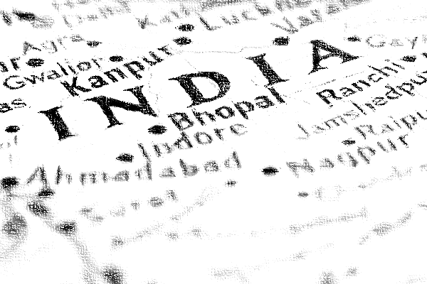
India Knows Innovation
Innovation
World Bank:
Ranked India 24th in high-technology exports in 2012
High-tech exports valued over $12.4 billion (USD)
U.S. National Science Foundation:
India’s growth rate for science and technology article output outpaced the world, 2001-2011
Total world output grew ~2.8% per year
India’s output grew ~7.6% per year

Slide 4
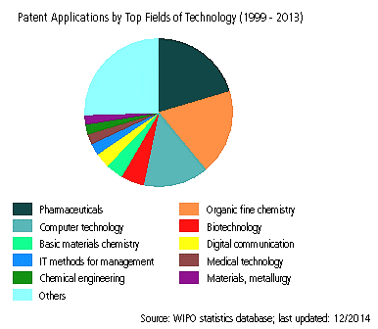
India & Patents
Innovation
2013 Indian Intellectual Property Filings (India & Abroad)
20,941 Patent
195,514 Trademark
6,101 Industrial Design
200-400% increase in filings since 2003

Slide 5
Protecting Innovation is Important
Innovation
United States Constitution
Article 1, Section 8:
“The Congress shall have Power . . . To promote the Progress of Science and useful Arts, by securing for limited Times to Authors and Inventors the exclusive Right to their respective Writings and Discoveries . . . .”

Slide 6
Recent U.S. Patents Issued to Indian Assignees
Innovation
Patent | Title | Assignee
8,933,248 | 3-substituted-3-hydroxy oxindole derivatives and process for preparation thereof | Council of Scientific & Industrial Research (New Delhi, IN)
8,933,123 | Polymorphic forms of O-desmethyl-venlafaxine succinate | Cadila Healthcare Limited (Ahmedabad, IN)
8,933,121 | Anti-obesity potential of Calebin A | Sami Labs Limited (Karnataka, IN)
8,933,060 | Combination of azelastine and ciclesonide for nasal administration | Cipla Limited (Mumbai, IN)
8,932,712 | Metal passivator additive and process for preparing | Indian Oil Corporation Limited (Faridabad, IN)
8,930,918 | System and method for SQL performance assurance services | Tata Consultancy Services Limited (IN)
8,930,381 | Methods and systems for runtime data anonymization | Infosys Limited (Bangalore, IN)
8,929,699 | Symmetrical branching ortho mode transducer (OMT) with enhanced bandwidth | Indian Space Research Organisation (Bangalore, IN)
8,929,622 | Method and apparatus for in vitro analysis of the physical response of blood-vessels to vaso-active agents | Manipal Institute of Technology (Karnataka, IN)
8,927,611 | Counter-current multistage fischer tropsch reactor systems | Bharat Petroleum Corporation Limited (Mumbai, IN)
8,927,256 | Fermentation medias and processes thereof | Biocon Limited (IN)
Notes:
24 Patents Issued on January 6 and January 13, 2015 with Indian Assignees
USPTO Patent Database
ICN Inventor Country IN 20,057
AACO Applicant Country IN 6,968
ACN Assignee Country IN 4,867
AC Assignee City Ahmedabad, IN 57

Slide 7
Recent U.S. Trademark Registrations to Indian Owners
Innovation
Registration | Mark | Owner
4,671,624 | ASSETEXPLORER | Zoho Corporation Pvt. Ltd. CORPORATION INDIA
4,671,723 | FUNGBACT | Patel, Babu Bhai C. TA M/S. Pramukh Agri Clinic INDIVIDUAL INDIA
4,669,024 | AIR HOCKEY : BEST & SUPER | Crispy Games Private Limited CORPORATION INDIA
4,666,900 | FORNEXT | ForNext Studios Indrani Vasanthraj - IN - Partner, Vasanthraj Chinnaswamy - IN - Partner PARTNERSHIP INDIA
4,665,992 | CAN SCRIPT | Mitra BioTech PRIVATE LIMITED COMPANY INDIA
4,665,706 | TRAVELXP | Celebrities Management Pvt. Ltd. Private Limited Company INDIA
4,663,138 | VWO | Wingify Software PRIVATE LIMITED Private Limited Company INDIA
4,664,759 | MAHINDRA FINANCE | Mahindra & Mahindra Limited CORPORATION INDIA
4,661,927 | 24 MANTRA ORGANIC | Sresta Natural Bioproducts Pvt Ltd CORPORATION INDIA
4,664,484 | SMART PROP | SLK Global BPO Services Pvt. Ltd. LIMITED LIABILITY COMPANY INDIA
4,658,806 | LUMIS PARTNERS | Lumis Consulting Partners India Private Limited private limited company INDIA
4,658,400 | ULLU | Vikramaditya Jain INDIVIDUAL INDIA
4,654,407 | GLITTERING STARS | GOLD STAR JEWELLERY PVT LTD. COMPANY INDIA

Slide 8
Enforcement
Using
IP Rights

Slide 9
The RIGHT to Exclude
IP Enforcement
Patent Act, 35 U.S.C. § 271, provides:
“[W]hoever without authority makes, uses, offers to sell, or sells any patented invention, within the United States or imports into the United States any patented invention during the term of the patent therefor, infringes the patent.”
Covers apparatus, method, and design patents
Addresses claims of direct, induced, and contributory infringement
Forum: U.S. Federal District Court

Slide 10
The RIGHT to Exclude
IP Enforcement
Lanham Act, 15 U.S.C. § 1125, et seq., provides:
“Any person who . . . uses in commerce any word, term, name, symbol . . . which [ ] is likely to cause confusion, or to cause mistake, or to deceive as to the affiliation . . . shall be liable in a civil action . . .”
Addresses trademark infringement, trademark dilution, false designation of origin, and other trademark-related claims
Forum: U.S. Federal District Court or state courts

Slide 11
The RIGHT to Exclude
IP Enforcement
Tariff Act of 1930, 19 U.S.C. § 1337 (“Section 337”), prohibits:
(A) Unfair methods of competition and unfair acts in the importation of articles . . .
(B) The importation into the United States . . . of articles that (i) infringe a valid and enforceable United States patent or . . . copyright . . .
(C) The importation into the United States . . . of articles that infringe a valid and enforceable United States trademark
Forum: United States International Trade Commission (USITC)

Slide 12
Section 337 Overview
Tariff Act? USITC?

Slide 13
What is Section 337?
Overview
U.S. trade remedy against foreign unfair competition
Authorizes investigation of unfair methods of competition, including IP infringement
Prohibits, with respect to accused articles
importation into the United States,
sale for importation, or
sale within the United States after importation
Not a market regulation or pricing law

Slide 14
What is the USITC?
Overview
Responsible for investigating violations of Section 337 and other trade matters
Independent administrative agency within executive branch of U.S. government
Not part of the judicial branch like district courts
The USITC Comprised of
Six Commissioners
Six Administrative Law Judges
Office of Unfair Import Investigations
Office of General Counsel
Notes:
Investigations are presided over by one of six Administrative Law Judges, who hear evidence and make an initial determination.
USITC is an independent, nonpartisan, quasi-judicial administrative agency in Washington, D.C.
Broad investigative powers on matters of trade
Administer U.S. trade remedy laws in a fair and objective manner
Maintain the Harmonized Tariff Schedule of the United States
Provide the President, the U.S. Trade Representative, and Congress with independent, quality analysis, information, and support on matters relating to tariffs and international trade and competitiveness
Same USITC that conducted the study “Trade, Investment, and Industrial Policies in India: Effects on the U.S. Economy,” Inv. No. 332-543 (Pub. No. 4501), which was published in December 2014
Section 332 allows the President, via USTR, or Congress, via the US Senate Finance Committee or US House Ways & Committee, can request that the ITC conduct a study on any economic issue and prepare a report
In the Section 332 India study, the USITC was investigating potential barriers for U.S. businesses to trade with and transact in India. However, in Section 337 investigations, the USITC is focused on imports and business activities in the U.S.
In investigating complaints under Section 337, the USITC plays a quasi-judicial role in adjudicating disputes between companies rather than conducting surveys and research and preparing a report on findings
USITC is headed up by Six Commissioners
Serve overlapping terms of nine years each
New term beginning every 18 months
Not political – equal party split
The six Commissioners, together, then review the decision, decide whether to uphold, amend or reverse it, and issue a remedial order if appropriate.

Slide 15
Section 337 Participants
Overview
Complainant(s) | Party who seeks investigation of Section 337 violation by filing a complaint
Respondent(s) | Party against whom complaint is filed, and whose conduct and articles are investigated
Office of Unfair Import Investigations | Neutral party who represents the public and often mediates between Complainant and Respondent.
Administrative Law Judge (ALJ) | Presides over investigation, collects evidence and issues an “initial determination” on merits.
Commissioners | Receive internal “appeal” of ALJ’s determination and decide whether to affirm, amend or reverse.

Slide 16
Section 337 Remedies
Overview
Limited Exclusion Order
Automatic remedy if Section 337 is violate
excludes infringing products of specific litigating party (in rem)
General Exclusion Order
excludes infringing products from all sources, whether source was a respondent or not (in rem)
Cease and Desist Order
Prohibits U.S. conduct if respondent that maintains commercially significant inventory of imported infringing goods (in personam)
No monetary damages at the USITC
Remedy must not be contrary to the public interest
Notes:
Exclusion Order Remedy Can be applied to:
Foreign Manufacturers
Foreign Exporters
U.S. Importers
Any intermediaries in chain of title from manufacture to sale within United States
Enforced by Customs and Border Protection
CDO prohibits, for example, advertising, sale, offer, sale from inventory, distribution, transfer, etc., of infringing goods

Slide 17
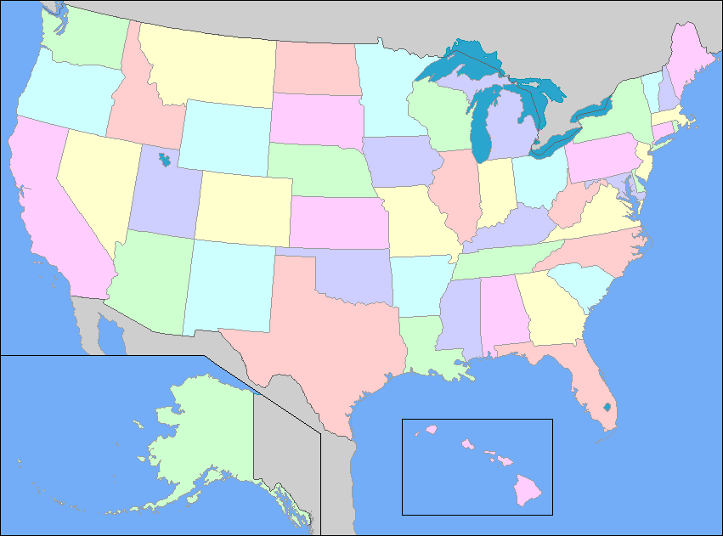
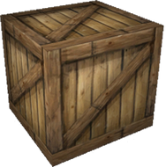
Remedy for a Section 337 Violation is a Prospective HALT
Overview

Slide 18
USITC & District Court - Parallel Actions
Overview
IP owner may still file case at the USITC for exclusion order and in District Court for damages
28 U.S.C § 1659(a)
Allows a respondent to seek a stay of district court claims identical to those in USITC action
Avoids fighting a case on two fronts
Record in USITC investigation may be used in district court
USITC decision may have preclusive effect on district court case brought or resolved later in time
Notes:
On preclusion:
- Determinations on non-patent issues have preclusive effect in any subsequent ITC or district court litigation
- Determinations on patent issues are not preclusive

Slide 19
The Many Benefits of Section 337
Why use it?

Slide 20
Section 337 is Unique
Benefits
Prospective Relief | Remedies prohibit future conduct like importation and sale
Automatic Enforcement | Exclusion orders direct U.S. Customs & Border Protection to seize products at the border
In rem Jurisdiction | Jurisdiction over articles so respondent need not be located in the U.S.
No Required Nationality | Complainant can be of any nationality as long as it has required U.S. activities and investments
Multi-respondent action | Can file a single complaint against several respondents, regardless of their locations
Notes:
Advantages of Section 337 for Complainants
Broad Discovery
Foreign party discovery – No Hague Convention concerns
Nationwide subpoena power
Automatic Protective Order
Effective Remedies
No eBay considerations
Spansion v. ITC, 629 F.3d 1331 (Fed. Cir. 2010)
In cases where violation is rampant, or a limited exclusion order directed to the named respondents would not be effective, a complainant may be able to prove that the unfair competition warrants broad relief against all known and unknown violators.

Slide 21
Section 337 is Unique
Benefits
Experienced Judges | ALJs have patent-heavy caseload and have experience with IP and high-tech cases
Protective Order | Automatic order protecting confidential business information from public disclosure
Foreign Discovery | Threat of default for failing to participate means non-U.S. parties tend to cooperate in discovery
Remedy against non-participants | In certain cases, a complainant may get relief against parties not named as respondents
Fast Adjudication | Statutory mandate for resolution “earliest practicable time”
Appeal to CAFC | Appeal of USITC final decision is directly to the U.S. Federal Circuit Court of Appeals in DC
Notes:
Advantages of Section 337 for Complainants
Broad Discovery
Foreign party discovery – No Hague Convention concerns
Nationwide subpoena power
Automatic Protective Order
Effective Remedies
No eBay considerations
Spansion v. ITC, 629 F.3d 1331 (Fed. Cir. 2010)
In cases where violation is rampant, or a limited exclusion order directed to the named respondents would not be effective, a complainant may be able to prove that the unfair competition warrants broad relief against all known and unknown violators.

Slide 22
Adjudication is Fast
Benefits
Investigation typically commences 1 month after complaint is filed
ALJ sets target date for completion of 14-18 months
Discovery usually lasts 4-7 months
Hearing is about 7-9 months after investigation is instituted
This means
Complainant may get relief in <2 years
Respondent must be ready to litigate when named in a complaint
Notes:
Resolution, Target Date: Currently between 13-15 months.
Effective Discovery, Remedies for failure to cooperate: Expedited procedures of ITC investigation provide little time for discovery disputes to drag on, as they might in District Court. Parties have numerous options for obtaining discovery from uncooperative opponents (from least to most severe): conference with ALJ, motion to compel, adverse inferences as evidentiary sanction, finding of default.
Effective Remedies: Exclusion orders and cease and desist orders go into effect 60 days after they are issued. Parties can increase effectiveness of orders by independent monitoring of retail channels and, in the case of exclusion orders, by coordinating with Customs and providing training manuals on infringing products.

Slide 23
Section 337 Timeline
Benefits
USITC Decision &
Order Issued
Complaint
Filed
Entry Only Under Bond
Judge’s
Decision
Investigation
Initiated
Hearing
Public
Interest
Requests
Commissioners’ Review
Presidential
Review and Exclusion
Discovery & Prehearing Filings
Posthearing Filings
Month -1 0 7 to 9 10 to 12 14 to 16 16 to 18
Notes:
Case length is short, typically less than 18 months from start to finish, and 5-9 months to hearing
Institution by Commission
30 days after Filing of Complaint
Notice of Investigation – Controls Scope of Investigation
Hearing
1-2 week bench trial before the ALJ
Initial Determination
ALJ’s decision on whether Section 337 has been violated
Petition for Review
Appeal to the USITC Commissioners to reverse, amend or uphold the ALJ’s Initial Determination
Only need one vote among the 6 Commissioners to get review of ALJ’s Initial Determination
Commissioners’ Opinion is Final decision of the USITC
Entry Only Under Bond
Applied if the respondents choose to continue importation during the 60-day Presidential review period.
The purpose of the bonding requirement is to protect the complainant from injury during this limited period.
Presidential Review
60 days – only for finding of violation
Rejections rare, but recent case was disapproved
Stainless Steel Pipe and Tube (1978)
Papermaking Machines (1980) (Modified)
Sandwich Panel Inserts (1982) (Modified)
Alkaline Batteries (1984)
Dynamic Random Access Memories (1989) (Modified)
Electronic Devices (2013)
Appeal to CAFC
Only by adversely affected party
In last 3 fiscal years, 61% of final determinations were appealed
Intervention by prevailing party
Stay of Remedy – Rare
Can also seek “Temporary Relief” in the form of a Temporary Exclusion Order before the investigation is completed on the merits essentially grants a preliminary injunction, but
standards to show likelihood of harm are very high,
timelines are extremely short (usually 90 days to USITC Commissioners’ determination), and
temporary relief is rarely granted - last TEO granted in 1996 - Hardware Logic Emulation Systems

Slide 24
Products are Accused by Category
Benefits
Caption of case reveals products at risk, for example:
Certain Light Emitting Diode Products
Certain Ink Cartridges
Certain Network Devices, Related Software and Components Thereof
Certain Wireless Devices, Including Mobile Phones and Tablets
Certain Stainless Steel Products, Certain Processes for Manufacturing or Relating to Same and Certain Products Containing Same
Products at risk are usually broader than model numbers accused in complaint

Slide 25
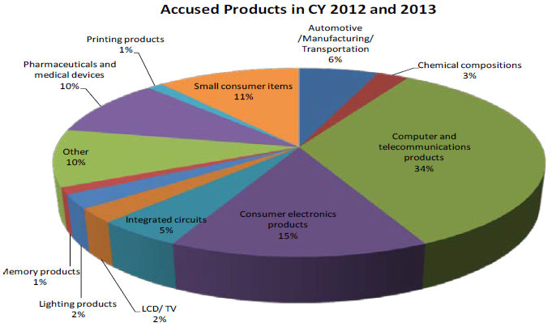
Used for Broad Range of Products
Benefits
Facts & Trends Regarding USITC Section 337 Investigations
Prepared by the U.S. International Trade Commission (April 15, 2013)
Notes:
Top categories of products involved in USITC Section 337 investigation have tended to be computer and telecommunications products and consumer electronics products.
However, this trend cannot be seen as a limitation; in the last two years, I have personally worked on Section 337 cases involving cell phone protective cases, chlorine bleach, tires, surgical devices and sneakers.

Slide 26
Elements of Section 337
How to litigate?

Slide 27
Basic Elements of a Section 337 Violation
Elements
Unfair Act or Method of Competition includes infringement of a valid and enforceable patent, trademark, or copyright, and other anticompetitive conduct
Importation of Articles into the United States, the sale for importation, or the sale within the U.S. after importation by the owner, importer or consignee of articles
Domestic Industry related to the articles protected by the patent or trademark exists, or is in the process of being established
Notes:
3 Basic Elements or Proofs:
some kind of unfair act – patent, copyright or trademark infringement, trade secret misappropriation, false designation of origin
Importation of an accused article
an industry in the U.S. that uses the technology at issue

Slide 28
Domestic Industry
Elements
Technical Prong
IP must be practiced or used by the IP owner
Basically an infringement analysis
Economic Prong
significant investment in plant and equipment
significant employment of labor or capital; or
substantial investment in its exploitation, including engineering, research and development, or licensing
Does not apply in investigations of general unfair methods of competition
Notes:
The purpose of the Commission is to adjudicate trade disputes between U.S. industries and those who seek to import goods from abroad.
The domestic industry requirement is imposed “to prevent the ITC from becoming a forum for resolving disputes brought by foreign complainants whose only connection with the United States is ownership of a U.S. patent.”

Slide 29
Domestic Industry Requirement is Like India’s “Local Working Requirement”
Elements
Section 146(1) of India’s Patents Act, 1970 | Section 337(a)(2) of U.S. Tariff Act of 1930
“The Controller may . . . require a patentee or a licensee, exclusive or otherwise, to furnish to him . . . such information or such periodical statements as to the extent to which the patented invention has been commercially worked in India . . .” | Unfair acts may be found unlawful “only if an industry in the United States, relating to the articles protected by the patent, copyright, trademark, mask work, or design concerned, exists or is in the process of being established.”

Slide 30
Same Policies Underlie Domestic Industry and Local Working Requirements
Elements
Section 83 of India’s Patents Act, 1970 | Legislative History for 1988 Amendments to Section 337
“[P]atents are granted to encourage inventions and to secure that the inventions are worked in India on a commercial scale and to the fullest extent that is reasonably practicable without undue delay . . .” “[Patents] are not granted merely to enable patentees to enjoy a monopoly for the importation of the patented article; . . . ” | “[M]ere ownership of a patent or other form of intellectual property rights would not be sufficient . . . The owner of the property right must be actively engaged in steps leading to the exploitation of the intellectual property . . .” “[T]his statute is not intended to protect holders of U.S. intellectual property rights who have only limited contact with the United States . . . ”
Notes:
In 1988, Congress amended Section 337 to expand the types of activities that would qualify as a domestic industry to include Section 337(a)(3)(C), “substantial investment in its exploitation, including engineering, research and development, or licensing.”
The goal was to enable use of Section 337 by universities, independent inventors and intellectual property owners engaging in inventive activities and licensing their inventions for productive use, but not engaging in production-related activities for articles, such as manufacturing, testing, quality control, servicing, support, etc.

Slide 31
Public Interest
Elements
Products found in violation are excluded from entry into the United States unless the statutory public interest factors bar such relief
Public Interest Factors
Public health and welfare
Competitive conditions on the United States economy
Production of like or directly competitive articles in the United States
United State Consumers
Public Interest rarely bars relief
May be used as a basis to tailor remedy, rather than deny it
Notes:
Section 337 provides that, if a violation is found, the Commission "shall direct that the articles concerned, imported by any person violating the provision of this section, be excluded from entry into the United States" unless the statutory public interest factors preclude such relief
The Commission instituted a new policy (2010) of soliciting public interest comments at the time a new complaint is filed with the ITC
If requests are submitted, the Commission may authorize the ALJ to take information on public interest
Not all investigations implicate public interest concerns. Compare consumer goods to pharmaceutical products
Remedies tailored to safeguard the public interest
Baseband Processor Chips
Personal Data & Mobile Communications Devices

Slide 32
Increasing Use of Section 337
USITC’s Growing Popularity

Slide 33
Increasing Use of Section 337
Use of Section 337
1990
2000
2005
2010
3Q 2014
1990 – 2000
Average 12/Year
2001 – 2013
Average 35/Year

Slide 34
Section 337 Usage by Non-U.S. Based Complainants
Use of Section 337
2014
2013
2012
2011
2010
2009
2008
2007
2006
2005
2004
2003
2002
2001
2000
41%
29%
36%
39%
30%
35%
20%
28%
27%
33%
15%
5%
12%
17%
0%

Slide 35
Dispositions 2004 – 2014
Use of Section 337
Terminated Due to Arbitration
1%
Notes:
Focusing on determinations on the merits as to whether Section 337 has been violated by a respondent’s unfair acts, the USITC has historically been seen as a neutral forum and the near 50-50 split in complainant and respondent victories continues.
Including settlement as a favorable disposition for both sides, particularly given the avoidance of litigation expenses and risk of adverse outcome, the odds of success rise to nearly 70% for complainants and respondents alike.

Slide 36
Representative Usage by Non-U.S. Based Complainants (2013 - 2014)
Use of Section 337
Australia | ResMed Ltd (2013)
Belgium | Federal-Mogul S.A. (2013)
Canada | Neptune Technologies & Bioresources Inc.; Acasta Pharma Inc. (2013); ViXS Systems, Inc. (2014)
China | Fellowes Office Products (Suzhou) Co. Ltd (2013)
Japan | Toyo Tire & Rubber Co., Ltd.; Furuno Electric Co., Ltd. (2013); Canon Inc. (2014)
Korea | Samsung Electronics Co., Ltd. (2013)
Mexico | Delmex de Juarez S. de R.L. de C.V. (2014)
Norway | Navico Holding AS (2013 and 2014)
Switzerland | Tyco Fire & Security GmbH; Baxter Healthcare SA (2014)
Taiwan | Macronix International Co., Ltd. (2014)

Slide 37
Indian Companies Have Been Named as Respondents under Section 337
Use of Section 337
933 | Stainless Steel Products, Certain Processes for Manufacturing or Relating to Same, & Certain Products Containing Same | Bebitz Flanges Works Pvt. Ltd., Viraj Holdings P. Ltd., Viraj Profiles Limited
766 | Gemcitabine & Products Containing Same | Intas Pharmaceuticals Ltd.
644 | Composite Wear Components & Products Containing the Same | AIA Engineering
635 | Pesticides & Products Containing Clothianidin | Crop Protection Section
584 | Alendronate Salts & Products Containing Same | CIPLA LTD.
546 | Male Prophylactic Devices | Reddy Medtech, Ltd.
539 | Tadalafil or Any Salt or Solvate Thereof, & Products Containing Same | Express Generic
522 | Ink Markers & Packaging Thereof | Luxor International Pvt. Ltd.

Slide 38
When to Consider ITC
Use of Section 337
No
Is the infringing good imported?
Yes
File complaint in U.S. District Court
Is it difficult to obtain jurisdiction over all infringers in one district court action?
Yes
File complaint at the ITC
No
No
Is the true infringer overseas?
Yes
Notes:
Flowchart demonstrates questions that demonstrate when the ITC may be an appropriate forum for enforcing intellectual property rights

Slide 39
KEY TAKEAWAYS
If you remember nothing else

Slide 40
For a potential Complainant...
Takeaways
Stopping infringing imports into the U.S. can provide very effective relief
Document each respondent’s conduct, products and importation
Solidify the basis for domestic industry
Determine settlement posture early
Prepare for rapid offensive and defensive discovery
Notes:
Complaint must include facts and develop basis for case before filing complaint. Cannot just make assertions or statements “on information and belief.” Can’t advance a claim without documentation so have to invest resources to develop best cause of action.
In the complaint, have to identify
respondent’s unfair conduct (patent infringement, trademark infringement, passing off),
respondent’s products implicated by that conduct,
proof the respondent’s products were imported
complainant’s domestic industry article
complainant’s activities and investments related to its domestic industry article

Slide 41
If named as a Respondent...
Takeaways
Understand claims and products at issue
Assess business and legal strengths and weaknesses
Decide on strategy with your advisors
Comply promptly with discovery obligations
Avoid losing offensive discovery opportunities by delay
Notes:
USITC has 30 days after receiving a complaint to assess whether it contains the required information and institute an investigation. Almost all complaints lead to investigations
While complaint is pending, and in first 30 days after institution, a lot of strategic gains can be made or lost.
As soon as a business finds out it has been named in a complaint, need to find experienced legal counsel and quickly execute steps 1-5.

Slide 42
Thank You
Questions?
Asha Allam
1133 Connecticut Avenue NW
Washington, DC 20036
United States
Tel: 001.202.467.6300
allam@adduci.com

